Slide 1
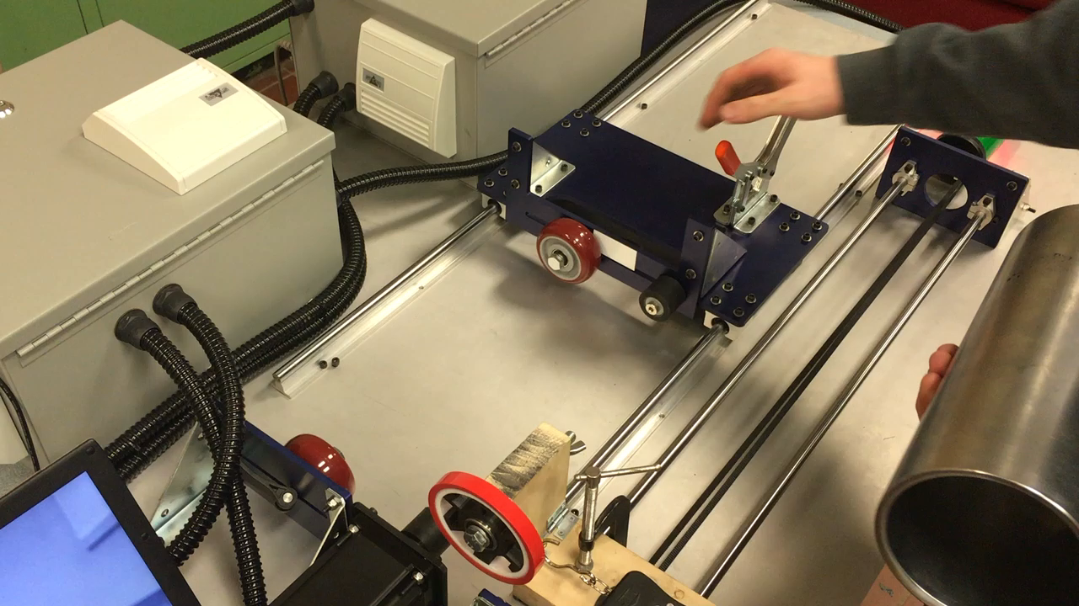
Systems - Moveable End Plate
Anodized aluminum endplate supported by linear bearing on rods.
End plate allows for part lengths of 1” to 30”
Plate held in place by quick clamp

